Slide 1
NE 591: Advanced Reactor Materials
Fall 2021
Dr. Benjamin Beeler

Slide 2
Project #2
Minor actinide bearing metallic fuels - Mahmoud
Swelling of stainless steel under fast fluence - Hamdy
Alternate geometries of metallic fuels (e.g., slotted) – Khadija
15 minute presentations + 5-10 for questions
Due date Oct. 14

Slide 3
molten salts

Slide 4
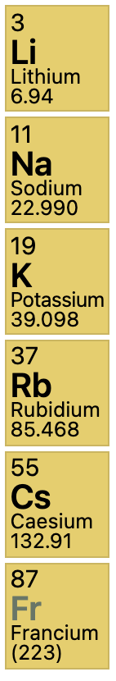
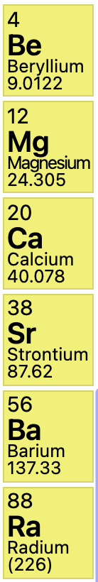
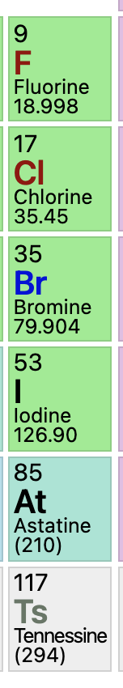
What are molten salts?
Alkali Metals
Alkaline Earths
Halogens
Salts are ionic compounds formed from a combination of electronegative and electropositive elements
At elevated temperatures salts liquefy and are termed “molten salts”
Halide salts are ionic compounds formed from the combination of a halogen (electronegative) and another electropositive element – commonly, but not exclusively, alkali metals or alkaline earths
Examples: LiF, BeF2, MgCl2, NaCl (aka table salt), ZrF4, RbF, UF4, UCl3

Slide 5
Molten Salt Reactors
Salt Cooled Reactor
Driven by some traditional fuel type in cladding, where the coolant is replaced with molten salt
Static Salt Fueled Reactor
The fuel itself is a liquid actinide-salt mixture contained in a cladding, often coupled with a salt coolant
Flowing Salt Fueled Reactor
The fuel itself is a liquid actinide-salt mixture which flows in a loops through the core and doubles as the coolant

Slide 6
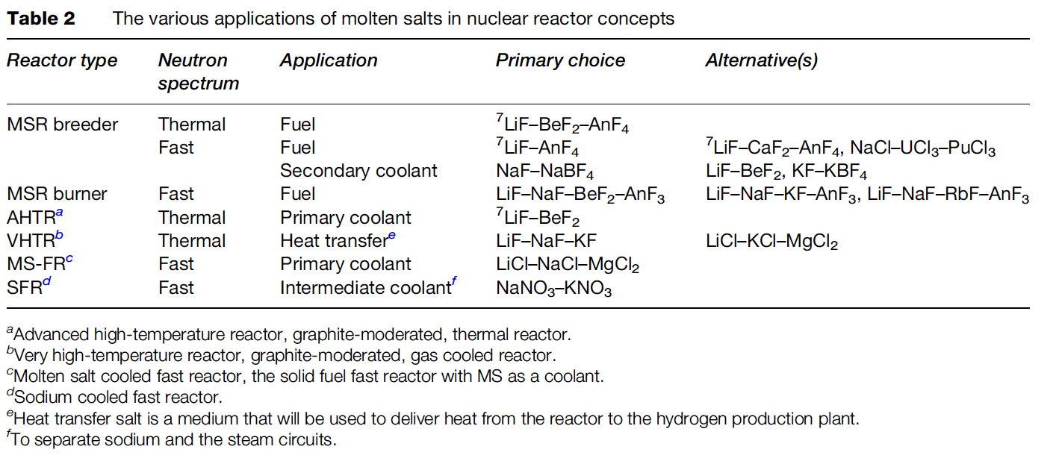
Molten Salt Applications

Slide 7
Benefits of MSRs
MSRs operate at or close to atmospheric pressure, rather than the 75-150 times atmospheric pressure of typical light-water reactors (LWR)
This reduces the large, expensive containment structures used for LWRs
Radioactive fission gases can be naturally absorbed into the molten salt
MSRs can have higher operating temperatures than a traditional LWR, providing higher electricity-generation efficiency, the possibility of grid-storage facilities, economical hydrogen production and, in some cases, process-heat opportunities.

Slide 8
Challenges of MSRs
The corrosivity of hot salts can break down cladding components and leech alloying elements
The changing chemical composition of the salt as it is transmuted by reactor radiation leads to changing properties
The processing of liquid transuranic molten salt fuel from the current spent fuel and of the on-line reprocessing of MSR fuel need to be solved

Slide 9
Beginning of MSRs
Aircraft Reactor Experiment was a 2.5 MWth thermal-spectrum nuclear reactor experiment designed to attain a high power density and high output temperature for use as an engine in a nuclear-powered bomber aircraft
It used the molten fluoride salt NaF-ZrF4-UF4 (53-41-6 mol%) as fuel, was moderated by a hexagonal-configuration beryllium oxide (BeO), and had a peak temperature of 860C

Slide 10
MSRE
The Molten-Salt Reactor Experiment (MSRE) was an experimental molten salt reactor at the Oak Ridge National Laboratory (ORNL); it went critical in 1965 and was operated until 1969

Slide 11
MSRE
MSRE was a circulating fuel type, utilizing LiF-BeF₂-ZrF₄-UF₄
The secondary coolant salt was LiF-BeF₂ (FLiBe), and the moderator was graphite
Salt-facing component were made of Hastelloy-N, which is a low chromium, nickel–molybdenum alloy

Slide 12
Fuel and Coolant Salts
A fuel salt is a molten salt that contains fissile material
Fuel salts consist of a mixture of some of all of the following:
Fissile material
Fertile material
Solvent (Lowers melting point, Decreases power density, Decreases viscosity)
Fissile oxidation prevention material
Fission products
Coolant salts are molten salts with advantageous heat transfer properties

Slide 13
Fuel Salt Requirements
Low neutron absorption
Radiolytic stability under in-core conditions
Dissolve fissile materials
High heat capacity, high boiling point, high thermal conductivity fluids
Melting point below ~525C
Relatively insensitive to fission products
Both fluoride and chloride salts, under mildly reducing conditions, are reasonably compatible with high temperature structural alloys and graphite

Slide 14
Fuel Salt Classes
Thermal spectrum reprocessing optimized fluoride salts
FLiBe (⁷LiF-BeF₂) and NaF-ZrF₄
FLiBe produces tritium, while NaF-ZrF₄ has a higher vapor pressure
Fast spectrum and thermal spectrum, once-through fuel cycle optimized fluoride salts
LiF-ThF₄-UF₄-(TRU)F₃
Much higher fissile loading (actinide-rich eutectics)
Adequate fissile material content is a significant design challenge
Chloride salts
Enables harder neutron spectrum and enhanced breeding
Isotopically separated chlorine preferable - ³⁵Cl from ³⁷Cl, due to moderate capture cross section of ³⁵Cl

Slide 15
Fluorides or Chlorides
Fluoride fuel salts have substantially more experimental data than chloride fuel salts, primarily due to history of MSRs in the thermal spectrum
Fluorides have been operated in molten salt reactors, been tested in multiple in-pile loops, with many capsule tests
Chloride salts have a history of laboratory measurements of physical properties, but no in-core testing of fuel salts
have extensive use in pyro-processing

Slide 16
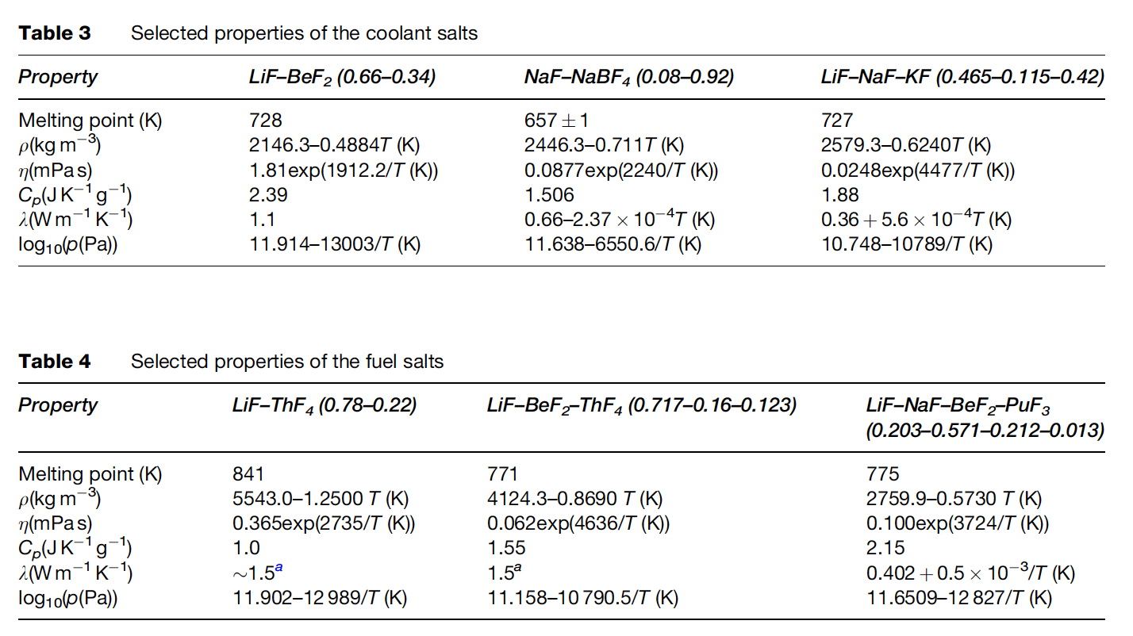
MSR Fuels
The fuel in the MSR must fulfill several requirements with respect to its physical and chemical properties
These include low melting point, high solubility of relevant species, low viscosity, high heat capacity, high thermal conductivity, low volatility/vapor pressure, neutron transparency

Slide 17
Neutron Economy
Thermal spectrum molten salt fuels were identified as candidates for breeding (converting fertile into fissile), specifically in the thorium fuel cycle
Li-Be-F salts were selected because of the low thermal neutron cross sections of ⁷Li (σ_{th} = 0.045 b) and Be (σ_{th} =0.0088 b)
Natural lithium cannot be used as part of the nuclear fuel as it contains about 7.6% of ⁶Li (the remaining 92.4% is ⁷Li), which has a very high parasitic neutron capture cross-section (σ_{th} = 940 b)
Therefore, enrichment of ⁷Li is required before it can be used in the core

Slide 18
Fast Spectrum MSRs
Current MSR designs move away from thermal graphite-moderated concepts, and favor non-moderated concepts that have a fast(er) neutron spectrum and can function to burn radioactive waste
Fuel selection for the non-moderated reactor concepts is more flexible, and elements other than ⁷Li can be considered
The neutron capture cross-section of the alkali halides and alkali-earth halides is generally lower in the ‘fast’ spectrum than in the thermal spectrum
Compounds like NaF, KF, RbF, or CaF2 can be considered as part of the fuel matrix
There are also some ‘fast’ MSR concepts which are based on chloride salts

Slide 19
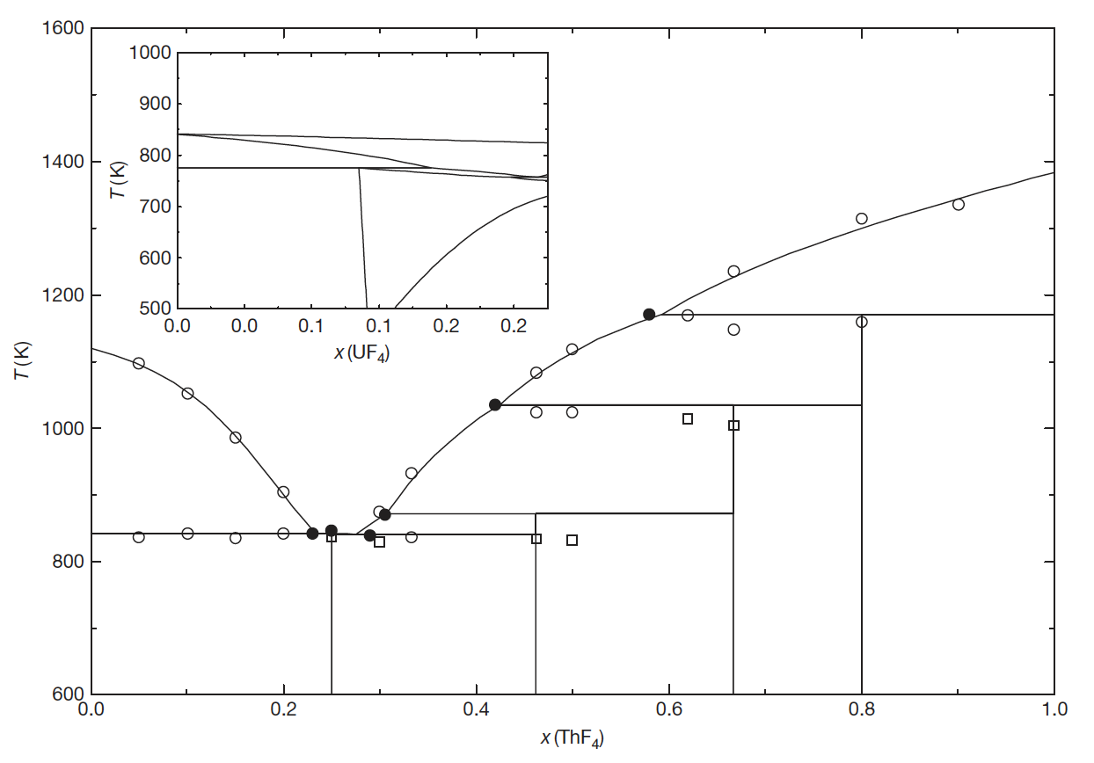
Solubility
The solubility of ThF4 in a matrix of LiF can be deduced from the binary phase diagram
For example, the solubility of ThF4 in a melt of LiF for T 903K (inlet temperature of the MSFR) is between 20.0 and 32.3 mol%
Compositions in this range are, thus, of interest as fuel for MSRs
Similarly, eutectic composition and melting temperature are key factors that govern the utilization of specific salts

Slide 20
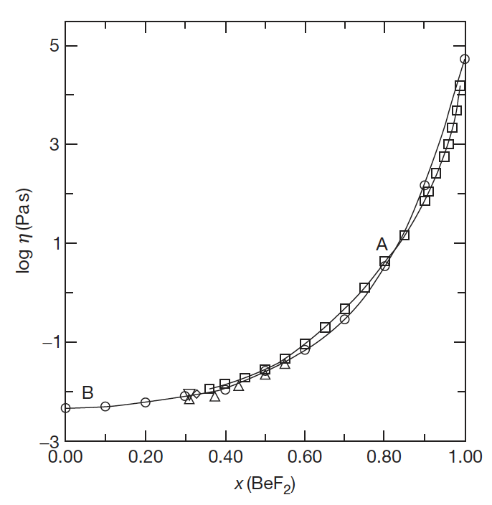
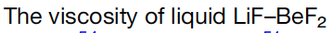
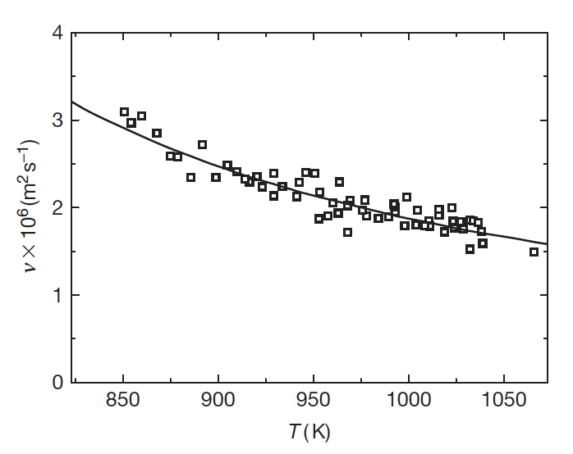
Low Viscosity
The viscosity of a fluid is a measure of its resistance to deformation at a given rate; conceptualized as the internal frictional force that arises between adjacent layers of fluid that are in relative motion
Lower viscosity results in less force to move the fluid at a given velocity
It is sometimes more convenient to utilize the kinematic viscosity, defined as the ratio of the viscosity μ to the density of the fluid ρ
The viscosity of fluoride systems shows significant non-ideal mixing behavior
Thus, it is not possible to accurately estimate the viscosity of the fluoride salts from its constituents, and therefore more measurements are required

Slide 21
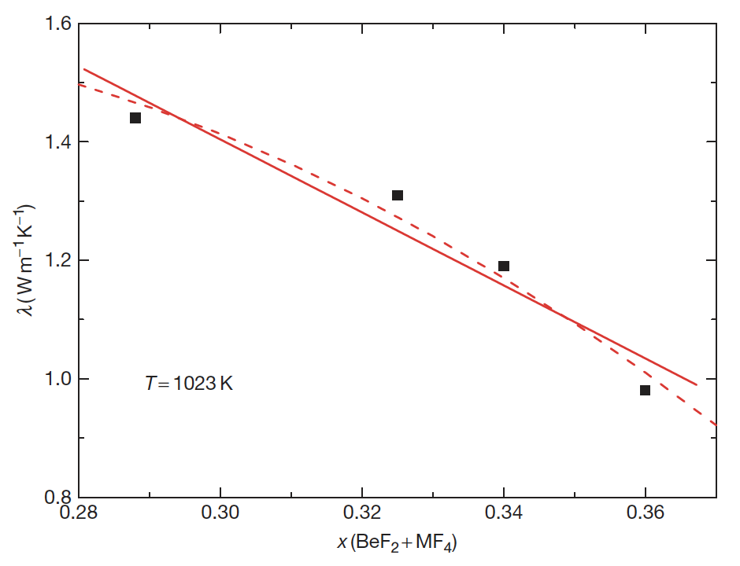
Heat Capacity and Thermal Conductivity
Heat Capacity is defined as the amount of heat to be supplied to an object to produce a unit change in its temperature
High heat capacity enables a small amount of the refrigerant to transfer a large amount of heat very efficiently
Data on experimental heat capacity and thermal conductivity of molten fluoride systems containing actinide fluorides are generally lacking
The thermal conductivity of a material is a measure of its ability to conduct heat
High thermal conductivity and thermal diffusivity will increase the rate of heat transfer through the fluid

Slide 22
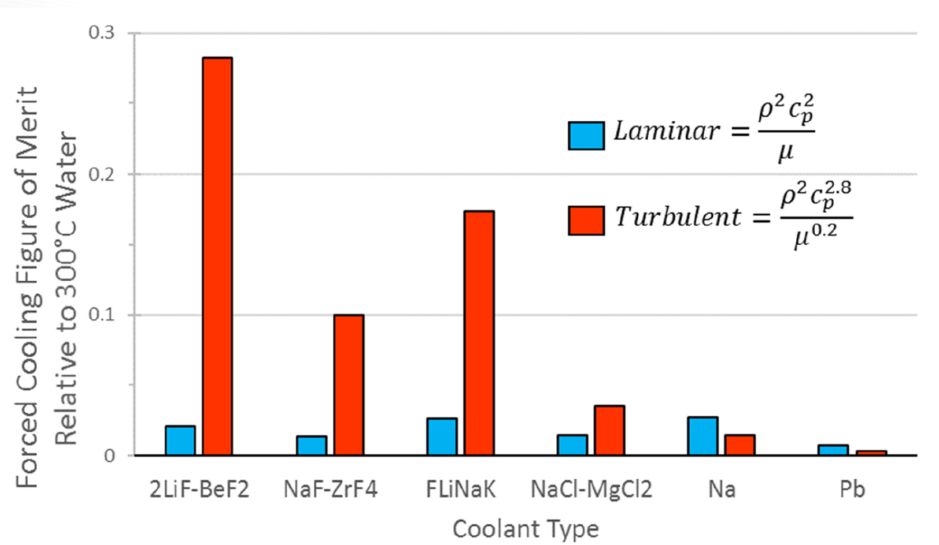
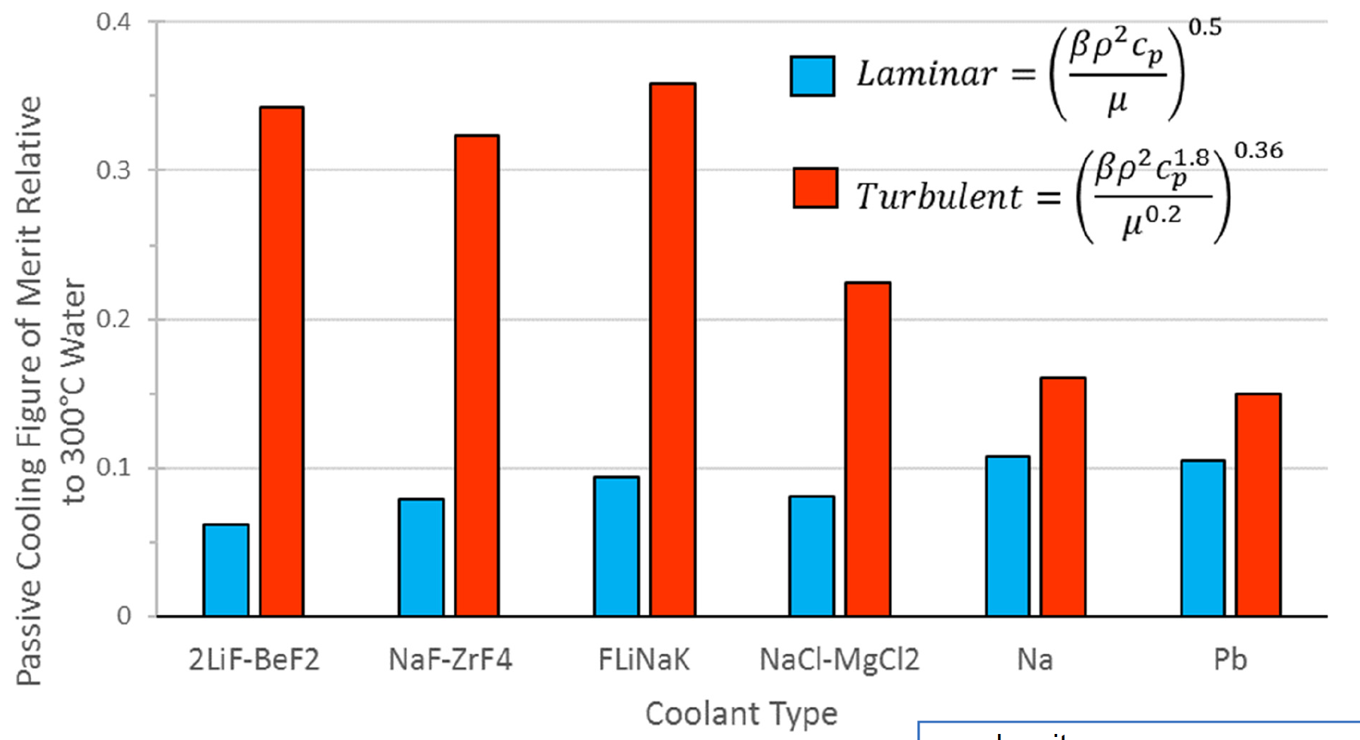
Heat Transfer
Large heat capacity and low viscosity are key properties allowing good heat transfer in molten salts
In both forced flow and passive cooling conditions, molten salts out perform liquid metals in turbulent flow for heat transfer
However, experimental data for heat transfer is still significantly scattered for the range of relevant MSR conditions

Slide 23
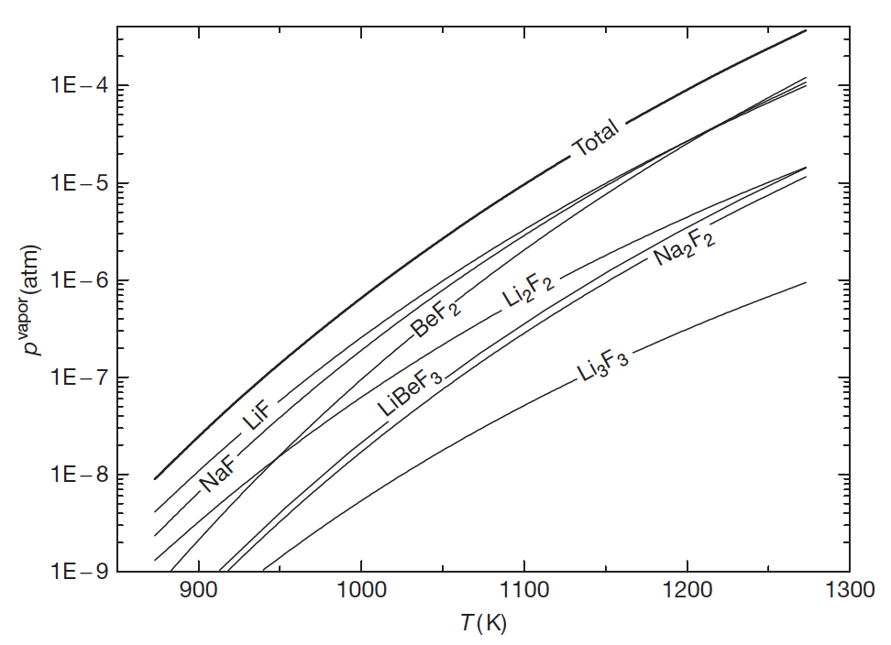
Vapor Pressure (Volatility)
Volatility is a material quality which describes how readily a substance vaporizes
A substance with high volatility is more likely to exist as a vapor, while a substance with low volatility is more likely to be a liquid or solid
Vapor pressure is a measurement of how readily a condensed phase forms a vapor at a given temperature
High vapor pressures indicate a high volatility, while high boiling points indicate low volatility
Salts should have high boiling and low freezing points, in addition to a low vapor pressure (low volatility)

Slide 24
Chemical Compatibility
For any high-temperature application, corrosion of the metallic container alloy is a primary concern
The products of oxidation of metals by molten salts tend to be completely soluble in the corroding media
Due to this solubility, passivation is precluded and the corrosion rate depends on other factors, including oxidants, thermal gradients, salt flow rate, and galvanic coupling
Examination of the free energies of formation for typical alloy components shows that chromium is the most active metal component
Thus, any oxidative attachment to these alloys should be expected to show selective attack on the chromium
Stainless steels, having more chromium than Ni-based alloys, are more susceptible to corrosion by fluoride melts

Slide 25
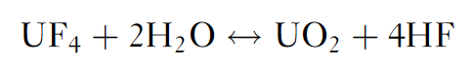
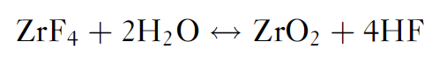
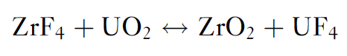
Role of Oxygen Impurities
The behavior of these systems can be significantly affected by the presence of the oxide ion that might be resulting from contamination of the salt system
Actinide oxides, such as UO2, can precipitate out for oxygen concentrations as low as 1E-4
Metal oxides have much higher melting points and therefore appear as insoluble components at operating temperatures
ZrF4 was implemented as an oxygen getter in the original MSRE fuels
AlCl₃ or CCl₄ can also be used as reactants to tie up oxygen, or strip O from UO2

Slide 26
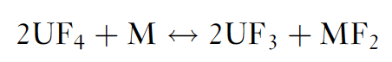
Role of Oxygen Impurities
Redox processes responsible for attack by fluoride mixtures on the alloys result in selective oxidation of the contained Cr
This removal of Cr from the alloy occurs primarily in regions of highest temperature
The rate of corrosion has been measured and was found to be controlled by the rate at which chromium diffuses to the surfaces undergoing attack
Reaction of UF₄ with structural metals (M) is strongly temperature dependent, and when the salt is circulated, a mechanism exists for mass transfer and continued attack
This reaction is of significance mainly in the case of alloys containing relatively large amounts of chromium

Slide 27
Control of Chemistry
Avoiding corrosion in an MSR or in fuel-processing units with metallic components is significantly more challenging than avoiding corrosion in clean salt coolant applications
The dissolved uranium and other such species in the fuel salt result in the presence of additional corrosion mechanisms
In clean salt applications, these types of corrosion mechanisms can be reduced or eliminated by (1) using purified salts that do not contain chemical species that can transport chromium and other alloy constituents or (2) operating under chemically reducing conditions
Redox control could be accomplished by including an HF/H₂ mixture

Slide 28
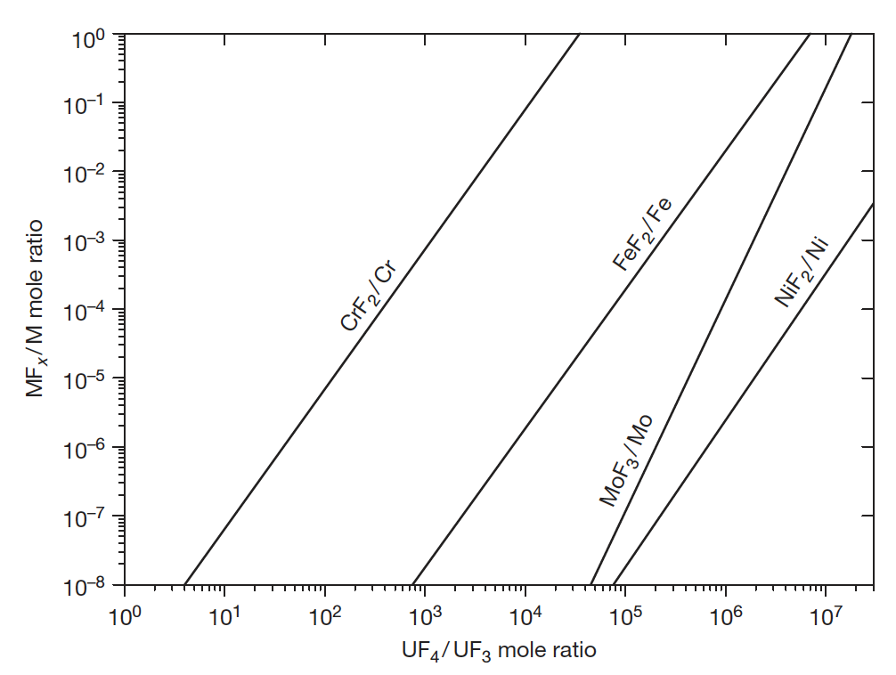
Maintaining Reducing Redox Conditions
Maintaining mildly reducing redox conditions is the key to enabling use of engineering alloys
Use of a circulating redox buffer provides means to maintain redox condition, while the oxidation states are changing due to fission
The ratio of U4+/U3+ serves as a measure of the redox potential of the salt for both chlorides and fluorides
Bottom right is the variation of equilibrium concentration of structural metal fluorides as a function of the UF4/UF3 ratio in a molten salt reactor fuel

